Slide 1

Luke 5:1-11
Discerning God’s Call to Greater Influence

Slide 2
Luke 5:1-4
On one occasion, while the crowd was pressing in on him to hear the word of God, he was standing by the lake of Gennesaret, ² and he saw two boats by the lake, but the fishermen had gone out of them and were washing their nets. ³ Getting into one of the boats, which was Simon's, he asked him to put out a little from the land. And he sat down and taught the people from the boat. ⁴ And when he had finished speaking, he said to Simon, “Put out into the deep and let down your nets for a catch.”

Slide 3
Luke 5:5-8
⁵ And Simon answered, “Master, we toiled all night and took nothing! But at your word I will let down the nets.” ⁶ And when they had done this, they enclosed a large number of fish, and their nets were breaking. ⁷ They signaled to their partners in the other boat to come and help them. And they came and filled both the boats, so that they began to sink. ⁸ But when Simon Peter saw it, he fell down at Jesus' knees, saying, “Depart from me, for I am a sinful man, O Lord.”

Slide 4
Luke 5:9-10
⁹ For he and all who were with him were astonished at the catch of fish that they had taken, ¹⁰ and so also were James and John, sons of Zebedee, who were partners with Simon. And Jesus said to Simon, “Do not be afraid; from now on you will be catching men.”

Slide 5
Luke 5:11
¹¹ And when they had brought their boats to land, they left everything and followed him.

Slide 6
Luke 5:1-4
On one occasion, while the crowd was pressing in on him to hear the word of God, he was standing by the lake of Gennesaret, ² and he saw two boats by the lake, but the fishermen had gone out of them and were washing their nets. ³ Getting into one of the boats, which was Simon's, he asked him to put out a little from the land. And he sat down and taught the people from the boat. ⁴ And when he had finished speaking, he said to Simon, “Put out into the deep and let down your nets for a catch.”

Slide 7
Luke 5:1-4
The Call begins with a test of character.
Question: Will you obey even when you don’t understand?

Slide 8
Discerning Character Tests
Dr. Robert Clinton, The Making of a Leader
The Word Check
The Obedience Check
The Integrity Check

Slide 9
The Word Check - Definition
A process item that tests a leader’s ability to receive or understand a word from God personally and then allow God to work it out in his or her life. When successfully passed, a word check will lead to more truth.

Slide 10
The Word Check - Importance
A leader must have the ability to receive truth from God. Receiving truth from God, is essential because it builds spiritual authority, which is the basis for influence. The right to influence comes from the ability to clarify God’s truth to others. Truth will confirm the emerging leader’s capacity to lead, which will yield increased spiritual authority as perceived by followers.

Slide 11
The Word Check - Examples
Samuel the prophet
Ananias
Watchman Nee and Charity Chang

Slide 12
The Obedience Check - Definition
A test through which a leader learns to recognize, understand, and obey God’s voice. God is testing a servant-leader’s personal response to revealed truth. In this test, obedience doesn’t hinge on understanding

Slide 13
What is Obedience?
Doing what has been asked the first time, without arguing or making excuses.
A good rule: Obey first, ask questions later.

Slide 14
The Obedience Check - Importance
Servant leaders are responsible for influencing specific groups of people to obey God. They will not achieve this unless they themselves know how to obey.
Obedience is first learned, then taught.

Slide 15
The Obedience Check - Examples
Abraham, Genesis 22 “Take your son,” God said, “your only son, Isaac, whom you love so much, and go to the land of Moriah. There on the mountain that I will show you, offer him as a sacrifice to me.”

Slide 16
The Obedience Check - Examples
Moses, Genesis 3
11 But Moses said to God, “Who am I that I should go to Pharaoh and bring the Israelites out of Egypt?”
12 And God said, “I will be with you. And this will be the sign to you that it is I who have sent you: When you have brought the people out of Egypt, you will worship God on this mountain.”

Slide 17
The Integrity Check - Definition
A test God uses to evaluate intentions in order to shape character.

Slide 18
Definition of Integrity
The uncompromising adherence to a code of moral, artistic, or other values that reveals itself in sincerity, honesty, and candor and avoids deception or artificiality.

Slide 19
The Integrity Check - Importance
The God-given capacity to lead has two parts: gifting and integrity. Integrity is foundational for leadership because it establishes trust and respect in relationships, which creates an environment where people flourish.

Slide 20
The Integrity Check - Examples
Peter and the Rooster
Daniel, Shadrach, Meshach, Abednego
Amy Carmichael
Landon Peterson

Slide 21
Discerning a Character Test
Big Idea: Jesus calls the apparently unqualified and often begins with a confusing test of character. However, the qualities he is looking for are humility, obedience, and integrity.

Slide 22
Luke 5:5-8
⁵ And Simon answered, “Master, we toiled all night and took nothing! But at your word I will let down the nets.” ⁶ And when they had done this, they enclosed a large number of fish, and their nets were breaking. ⁷ They signaled to their partners in the other boat to come and help them. And they came and filled both the boats, so that they began to sink. ⁸ But when Simon Peter saw it, he fell down at Jesus' knees, saying, “Depart from me, for I am a sinful man, O Lord.”

Slide 23

Responding to Kairos Moments
Chronos Time

Slide 24

Responding to Kairos Moments
Kairos Time

Slide 25
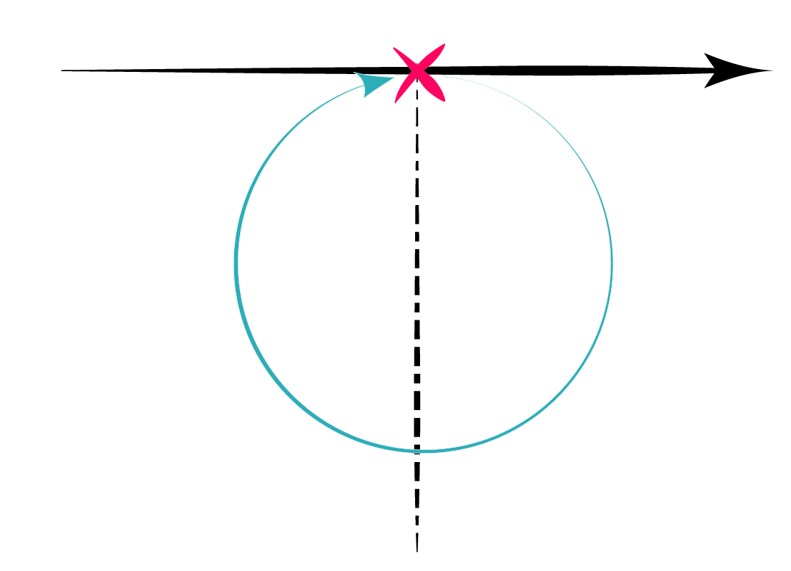
Responding to Kairos Moments
Enter the Learning Circle

Slide 26
Responding to Kairos Moments
Faith:
6. Act
5. Account
4. Plan
Repentance:
Pray
Reflect
Share

Slide 27
Responding to Kairos Moments
Simon (Peter) is experiencing God’s presence in a new way through Jesus.
The majesty of God, present in Jesus, is giving Peter a new awareness of his own depravity.
At this point in Peter’s life, this is a powerful display of humility.

Slide 28
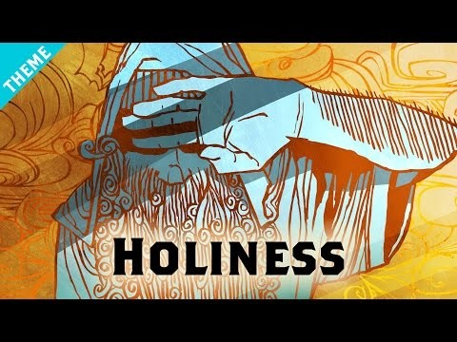
For More Information:
https://thebibleproject.com/explore/holiness/

Slide 29
Luke 5:9-10
⁹ For he and all who were with him were astonished at the catch of fish that they had taken, ¹⁰ and so also were James and John, sons of Zebedee, who were partners with Simon. And Jesus said to Simon, “Do not be afraid; from now on you will be catching men.”

Slide 30
v9-10 Expanded Influence
Passing the Obedience Check and responding to this Kairos moment with humility by entering the Learning Circle results in the Lord giving Simon a greater role in the Kingdom of God.

Slide 31
v9-10 Expanded Influence
Point to ponder: What is your level of influence? Is this by God’s design and your cooperation or is your influence limited by negligence, disobedience, or fear?

Slide 32
Luke 5:11
¹¹ And when they had brought their boats to land, they left everything and followed him.

Slide 33
v11 Reorganization
What can you leave behind to make room for the work Christ wants to do in and through you?

